Slide 1
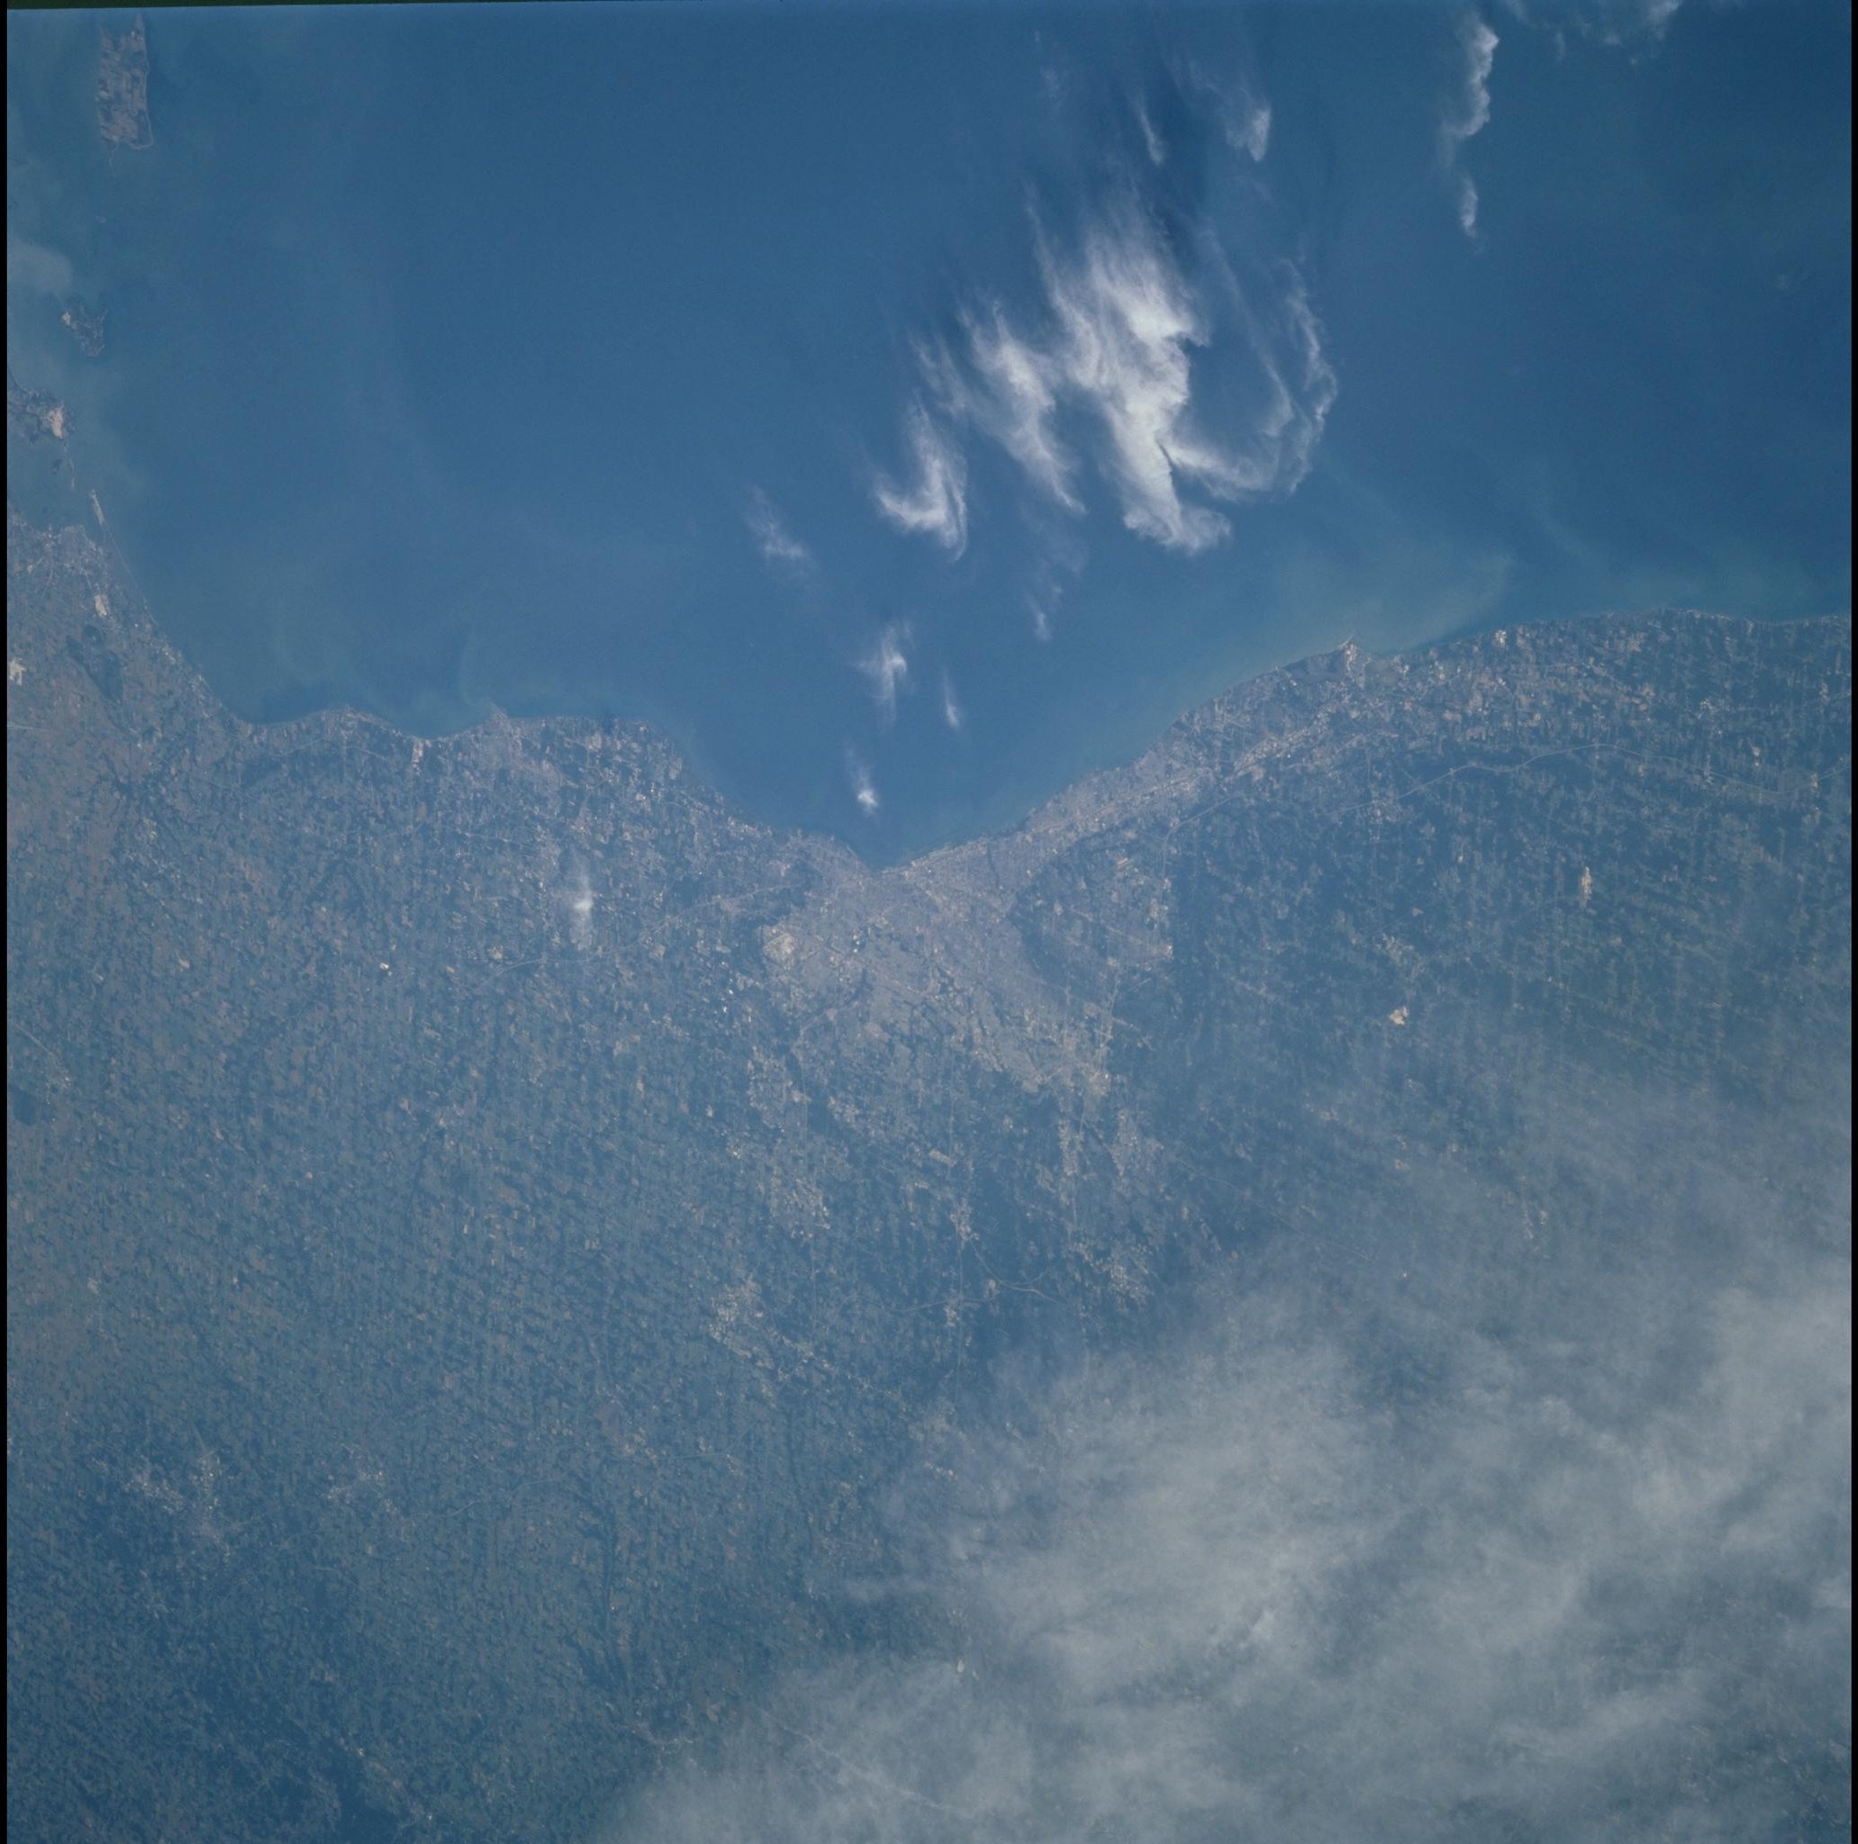
The Big Marble
NASA Space Apps Challenge 2013 - Cleveland

Slide 2
Team Members
Ryan Wilson
Dan Virost
Jeramiah Cieszynski
Nate Hodge
Matt Slagle

Slide 3
Challenge Overview
The Blue Marble
“Create an app, platform or website that consolidates a collection of space imagery and makes it more accessible to more people.”

Slide 4
Solution Overview
Provided a way for developers to more easily access the data by creating a public-facing RESTful API
Provided a way for anybody to more easily access the data by creating a website
Provided a way to push this data to the masses by creating a twitter account

Slide 5
Solution Overview – cont.
RESTful API
Big Marble Website
Big Marble Twitter Account
Anything your heart desires!
SQL Database
Marble in Motion

Slide 6
Public API - Overview
RESTful API
Available NOW:
http://bigmarble.azurewebsites.net/api/
Thorough Documentation and Examples
Currently have ~230k images geotagged in the database

Slide 7
Public API – Functionality
Given an address or location, will return all images containing that location
Detailed information about images
Location (Latitude and Longitude)
Mission
Features in Image

Slide 8
Public API - Example
IEnumerable<ImageData> GetImagesByAddress(string address)
Description: Returns all image data for a given street address. Uses the default range to search, with the street address as the center point.
api/image/?address=value
url example:
http://bigmarble.azurewebsites.net/api/image/?address=28500%20Clemens%20Rd,%20Westlake%20OH

Slide 9
Public API - Example
[TODO: Screen Shot of returned values]

Slide 10
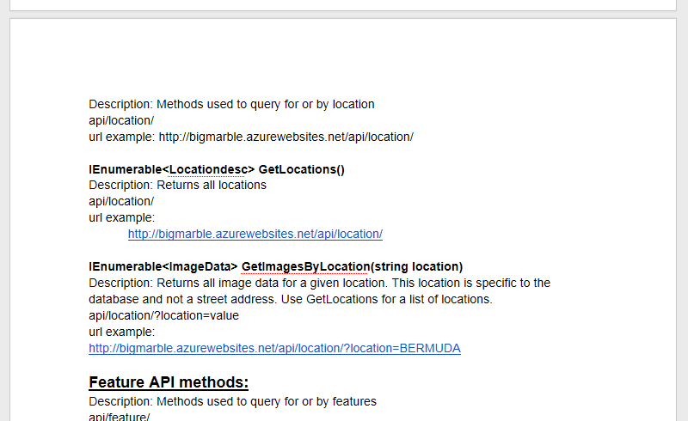
Public API – Documentation
Available now in a public Google Doc

Slide 11
Big Marble Website
Google-like interface so that anybody can more easily access the data
http://bigmarble.azurewebsites.net/
[TODO: screen shot of main page]

Slide 12
Big Marble Website - Overview
Hosting provided by Microsoft Azure
Uses the public RESTful API to retrieve all information
Simple and elegant interface with a strong back-end
http://bigmarble.azurewebsites.net/

Slide 13
Big Marble Website - Searching
Just type in an address or location and images are returned
Examples:
“2415 Woodland Ave, Cleveland, OH”
“Berlin, Germany”
“Amazon River”
“The Alps”
“Cleveland Browns Stadium”

Slide 14
Big Marble Website - Searching
[TODO Screenshot of the field populated, ready to Search]

Slide 15
Big Marble Website - Results
[TODO: decide on search criteria]
[TODO: screenshot of image results]

Slide 16
Big Marble Website - Results
Some of the metadata information is listed for each image returned
[TODO: screenshot of a single result]

Slide 17
Big Marble Website - Results
Clicking on an image shows a high resolution version
[TODO: screen cap]

Slide 18
Twitter Account - Overview
Provided a way to push this data to the masses by creating a twitter account
https://twitter.com/TheBigMarble (CHECK IT OUT!)
Posts a formatted message and a random image at regular intervals
Hosted on Windows Azure

Slide 19
Twitter Account – Main Page
[TODO screen shot]

Slide 20
Twitter – Individual Tweet
Provides a link to the image
Provide geodata about the image

Slide 21
Twitter – Individual Tweet
Clicking on the Link brings up the location in Google maps that the image was taken
[TODO screen shot]

Slide 22
Marble in Motion
A utility that uses the Big Marble API to create movies
Images are tagged with camera roll and frame
It combines sequential images together to make a GIF

Slide 23
Marble in Motion - Example
[TODO EMBED MOVIE]

Slide 24
Marble in Motion - Example
[TODO EMBED MOVIE]

Slide 25
Challenges Faced
Learning curve with new technologies
Database challenges – performance
Working in Git in a team environment
Tech compatibility issues

Slide 26
Next Steps
Additional Data Sets
Auto-Generated API Documention
Create a more robust API (standalone)

Slide 27
Conclusion
[TODO: …we have just provided a better way to access the data. Now let’s see what people can do with it!] word that better

Slide 28
Conclusion
Thanks to all involved including:
NASA
NEOSA
Tri-C

